Slide 1

Hackathon 2020 - 21
TEAM : TECHIE SCAVENGER
Members: Sruthi Aniyan Kumar,
Jayalakshmi J
Miya Mariam George
Sonah S Tiju

Slide 2
Area of interest : HealthTech

Slide 3
Problem to be addressed:
To create a solution to deal with the major challenge faced by the patients:-
Enabling a patient-centered information exchange system

Slide 4

BIG DATA IN COVID SCENARIO
Identify prevalence based on demography.
Pattern of Spread among populations.
Plan resources for treatment.
Production, delivery and administration of vaccines.
Analyse effectiveness of treatment modalities.
Identify after effects based on various factors.
Analyse Prognosis based on various data including
co-morbidities.

Slide 5
COVID-19 Crisis
As big data will be critical for managing the COVID-19 pandemic in today’s digital world, the conditions for responsible data collection and processing at a global scale must be clear. We argue that the use of digitally available data and algorithms for prediction and surveillance, i.e., identifying people who have travelled to areas where the
disease has spread or tracing
and isolating the contacts of
infected people—is of paramount importance in
the fight against the COVID-19 pandemic.

Slide 6
It is equally important, however, to use these data and algorithms in a responsible manner, in compliance with data-protection regulations and with due respect for privacy and confidentiality. Failing to do so will undermine public trust, which will make people less likely to follow public-health advice or recommendations and more likely to have poorer health outcomes.
The privacy issue is the main concern of the citizens.
TECHIE SCAVENGER HAS THE SOLUTION TO ALL THE WORRIES.

Slide 7
Our idea to address this issue:
Collection of data through a secure website
Protect the patient - centred info privacy
Reassure patients to protect their individual details against misuse Provide Hospitals a top quality info procuring website so that during the times of pandemics, the required details will be only a click away.
Ensure privacy protected data for analysis to the Government and Health authorities for planning out various interventions.

Slide 8
HERE WE PRESENT TO YOU A SMALL
GLIMPSE INTO OUR WEBSITE…

Slide 9
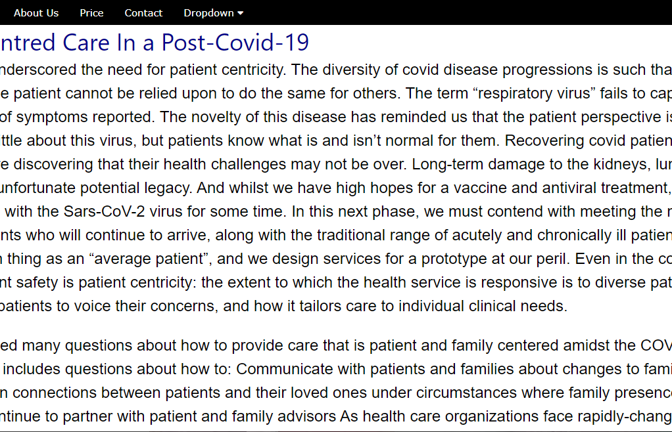
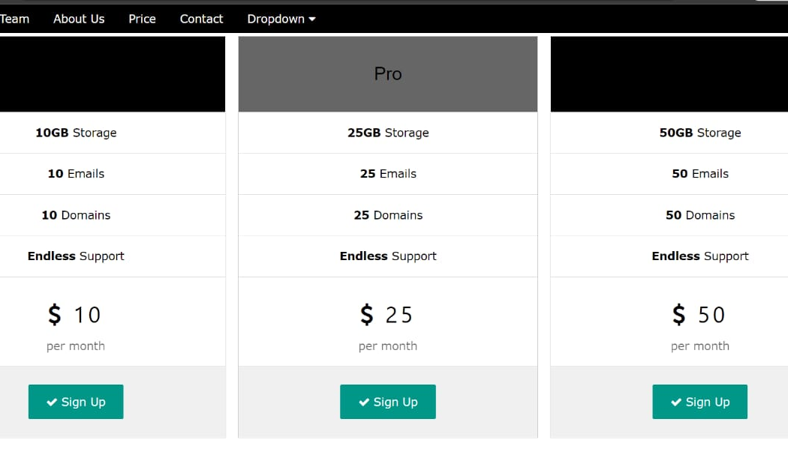
WEBSITE
SCREENSHOTS:

Slide 10
THANK YOU!

